Slide 1

Building Culturally-Valid Dynamic Facial Expressions for a Conversational Virtual Agent Using Human Perception
C Chen, OGB Garrod, RA Ince, ME Foster, PG Schyns, RE Jack

Slide 2
Introduction
Facial expressions are used to facilitate daily interactions including conversations.
The facial expressions of 'thinking,' 'interested,' 'bored,' and 'confused' are frequently used by humans across all cultures to facilitate the flow of a conversation.
Despite their central role in daily social interactions, little is known about which specific facial expressions convey such conversational messages and whether they are sufficiently similar across cultures to support successful cross-cultural communication

Slide 3
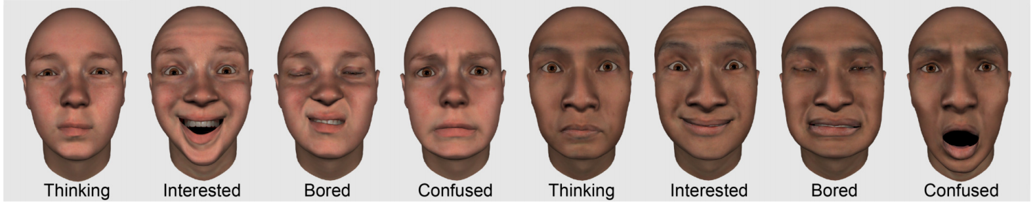
Motivation
To equip the conversational virtual agents with an essential repertoire of social signalling capability to guide the flow of a conversation.
This was accomplished by modeling the facial expressions of key conversational messages directly from cultural perception, and transferring them to a conversational virtual agent.
Facial expressions of conversational messages in Western European and East Asian culture

Slide 4
Deriving dynamic conversational facial expressions using cultural perception
APPROACH:
Perception-based data-driven psychological approach
PARTICIPANTS:
20 White Western European (males, mean = 21 [SD 2.3] years)
20 Chinese East Asian (males, mean = 23 [SD 2.1] years)

Slide 5
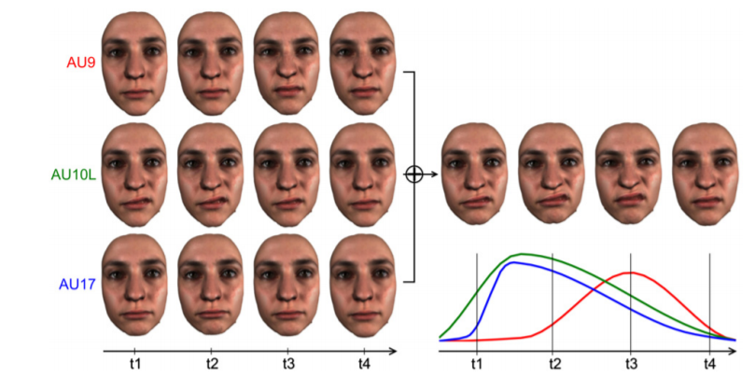
Dynamic Face Movement Generator
3D models are based on FACS codes.
FACS is a classification system for the visual appearance of facial muscle activations.
Random facial expression synthesis

Slide 6
Procedure
Multiple trials were conducted. Each trial consisted of two steps:
1) Generation of photo-realistic facial animation via a dynamic face movement generator.
2) capture a participant's categorization and rating of his perceived intensity for an animation.
The results from the trials were utilized to build a statistical relationship (using correlation and linear regression) between the face movements presented on each trial and the participant’s response.

Slide 7
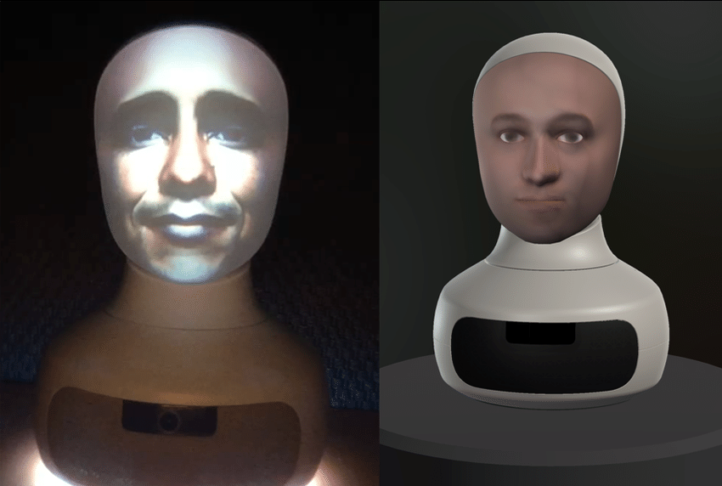
Transferring facial expression models to a conversational virtual agent
AGENT:
A popular 3D virtual agent, Furhat
APPROACH:
Equip the agent with the necessary vocabulary of 42 AUs.
Stimuli Generation: Displaying the facial expression models on 4 new same-ethnicity face identities, producing 320 facial animations (20 facial expression models × 4 conversational messages × 4 same-ethnicity face identities).
Furhat

Slide 8
Experiments
APPROACH:
On each experimental trial, participants viewed a conversational message labels and a facial animation (played once for 1.25s), then indicated if the animation matched with the label.
640 randomly ordered trials for each participant
PARTICIPANTS:
20 White Western European (females, mean = 23 [SD 1.2] years)
20 Chinese East Asian (females, mean = 23 [SD 3.2] years)

Slide 9
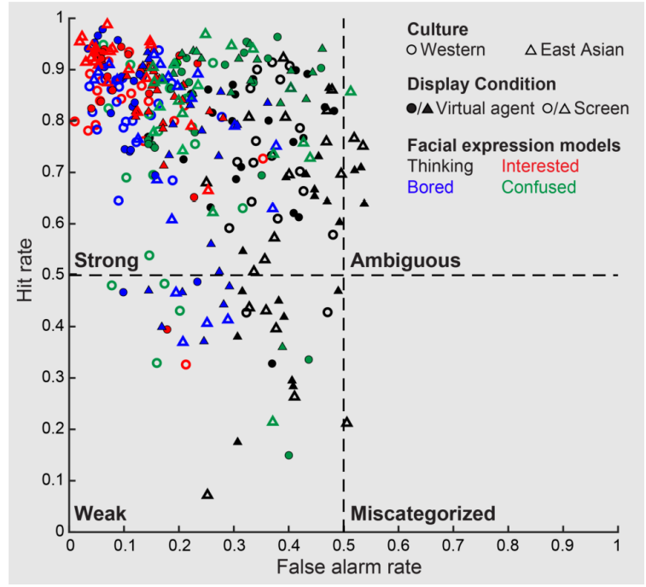
Results
For evaluating facial expression models, hit and false alarm rate were calculated for each display task separately using data pooled across participants.
125 facial expression models
Western: 18 thinking, 18 interested, 18 bored, 14 confused
East Asian: 6 thinking, 20 interested, 13 bored, 18 confused
Validation of conversational facial expression models on a 3D virtual agent and flat screen monitor.

Slide 10
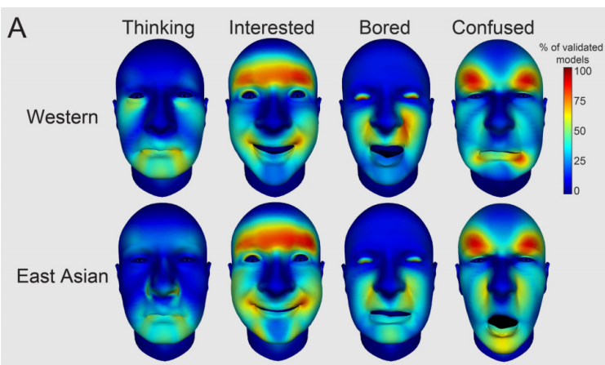
Results
Face movement patterns of each conversational message in each culture.

Slide 11
Cultural similarities and differences in conversational facial expression models
Metric:
An information theoretic approach based on Mutual Information (MI) is utilized to evaluate the similarities and differences. A low MI value between an AU and the variable culture indicates that the AU is common across cultures; a high MI value indicates that it is specific to one culture.

Slide 12
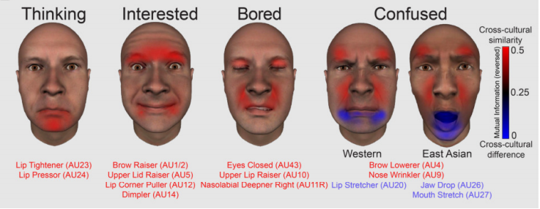
Observations
Cross-cultural similarities (red) and differences (blue)

Slide 13
Conclusion
The results demonstrate the power of deriving social signals directly from human cultural perception using psychological methods and the importance of cultural variance.
The models can be utilized in designing of conversational virtual agents, and the generic data-driven method can be used to derive further multimodal signals for social communication to enhance the utility and global marketability of virtual agents.

Slide 14
Discussion
Can the results be generalized to other cultures? If yes, will there be more similarity or differences?
If the model uses wrong or different way of expressing the conversational message, will it affect the conversation?
Can the modeling technique be useful in any other aspect?
Does the modeling technique significantly aid a virtual agent?

